Slide 1




Ethical AI in the Data Ecosystem An environmental scan

Slide 2

Purpose
Data ethics is central to an inclusive data ecosystem. With this scan, we explored how data ethics is being taught, expressed and implemented within Canada by three stakeholders in the data ecosystem:
Postsecondary Education Institutions
Data Service Providers
AI Firms
The scan focused on information available through online sources.

Slide 3
Postsecondary Education (PSE)

Slide 4
PSE Institutions Offering AI Education
29
PSE Institutions
48
Programs
Inclusion Criteria:
Artificial Intelligence (AI) topics such as machine learning and algorithm design are part of course descriptions.
Research focus:
Is AI ethics and fairness included in program curriculums?
Do any programs address minority groups or outliers?

Slide 5
Ethics Courses Within the 48 Identified Programs
30 Include an Ethics Course*
17 have required ETHICS courses
11 tackle algorithmic bias, fairness, & social issues**
3 address minorities
*Includes courses related to privacy, security, cybercrime
**Includes both required and elective courses

Slide 6
Education Level
Highest proportion of programs are at the graduate level

Slide 7
Geographic Distribution

Slide 8
Samples of Ethical AI Courses

Slide 9
Ethical AI Courses
University of British Columbia
Master of Data Science
Master of Data Science in Computational Linguistics
DSCI 541: Privacy, Ethics, & Security
Description:
The legal, ethical, and security issues concerning data, including aggregated data. Proactive compliance with rules and, in their absence, principles for the responsible management of sensitive data. Case studies on privacy, human dignity, harm, the public good, legal issues, the role of ethics boards, and consent.

Slide 10
Ethical AI Courses
Simon Fraser University
Master of Science in Data Science - Big Data Concentration
CMPT 3120: Social Implications
Description:
An examination of social processes that are being automated and implications for good and evil, that may be entailed in the automation of procedures by which goods and services are allocated. Examination of what are dehumanizing and humanizing parts of systems and how systems can be designed to have a humanizing effect.

Slide 11
Ethical AI Courses
Queen’s University
Master of Management Analytics
“AI Ethics & Policy”
Description:
This course explores the profound implications of AI on business and society. The ethical and policy issues linked with the application of AI in business are covered in-depth, including such issues as overcoming the job displacement due to AI by job creation, ensuring the public good as AI pervades the new economy, and balancing privacy and transparency in AI related endeavors.

Slide 12
Ethical AI Courses
University of Toronto
Master of Applied Computing in Data Science
CSC2541H: AI and Ethics - Mathematical Foundations and Algorithms
Description:
Machine learning systems are becoming increasingly important in many domains where they are used to make predictions and decisions that often have life-altering consequences. As these systems are becoming ubiquitous, it is important to address issues of privacy, fairness and accountability. Most of the course will focus on algorithmic fairness.

Slide 13
Ethical AI Courses
York University
Master of Management in Artificial Intelligence
Master of Business Analytics
PHIL 5340: Ethics and Societal Implications of Artificial Intelligence
Description:
This course is intended for students with professional interest in the social and ethical implications of AI. Topics include theoretical issues (could AI ever have moral rights?), practical issues (algorithmic bias, labor automation, data privacy), and professional issues (tech industry social responsibility).

Slide 14
Ethical AI Courses
University of Western Ontario
Graduate Specialization in Artificial Intelligence
CS 9622: Nonfunctional Software Requirements - Safety, Accessibility, & Sustainability
Description:
As we increasingly create a society where people have to interact with various automated systems, we need to be concerned about whether these systems could cause personal harm. More generally, there is the need to learn to design computer systems that are not implicitly biased in favor of one portion of the population over another.

Slide 15
Ethical AI Courses
University of Waterloo
Master of Data Science in Artificial Intelligence
Master of Mathematics in Data Science
CS 798: Artificial Intelligence Law, Ethics, and Policy
Description:
Students must complete a 3 day workshop on "Ethics in Data Science & Artificial Intelligence", alternatively, students can opt for CS 798 "Artificial Intelligence Law, Ethics, and Policy"

Slide 16
Ethical AI Courses
Ontario Tech University
Bachelor of Science in Data Science
CSCI 4040U: Ethics, Law, and the Social Impacts of Computing
Description:
The development of laws and social mechanisms has not kept pace with the rapid development of computing. The impact that computing has on society will be examined in light of the need for professional ethics and appropriate laws and regulatory agencies

Slide 17
Takeaways
Most AI education is through computer science or data science specializations at all PSE levels including continuing studies
Majority of ethical courses that address social implications and fairness are at the graduate level
Ethics and AI ethics are not showing as a priority across programs with only 17 out of 48 requiring ethics training
Bias and minority concerns are not addressed often, even in programs with ethics courses

Slide 18
Data Service Providers

Slide 19
Canadian Data Ecosystem Companies
27
Companies
5
Classifications
Inclusion Criteria:
Companies that are physically located in Canada, and/or service Canadian clients.
Research Focus:
Who are the most popular data service providers in Canada? What is the main messaging regarding their service approaches? How are they addressing bias management and inclusion?

Slide 20
Classification
Data service provision is a diverse space. Companies usually offer a combination of services such as provision, analysis, and software services. We categorized data services companies into 5 classes:
Classification | Description | Companies | %
Data Exchange | A marketplace where data sets are purchased from data providers, usually in raw formats. This is where 2nd and 3rd party data are purchased | AWS Data Exchange | 4%
Data Provider | Any company that wishes to sell its data either directly or on a data exchange | InfoCanada, Cleanlist, Direct Lead Data | 11%
Data & Insight Provider | Offer 3rd party data sets and helps curate and convert them into insights based on client needs | Pelmorex, Experian, AggregateIQ | 19%
Data Research & Intelligence Partner | Will conducts its own research such as surveys and focus groups. May also collect & curate data. Companies in this space will usually have a client facing consultatory practice | Kantar, Ipsos, Vividata | 22%
Data Solutions | Offer a combination of data services such as a data management platform (DMP), data exchange, data sets, analytic toolkits, data onboarding, and business services | Adobe Audience Manager, Liveramp, Salesforce | 44%
85% = provision + making sense of data

Slide 21
Overview of the 27 Identified Data Service Providers
20 Are US/EU based, with operations in Canada
11 Reference bias management
5 Address inclusion or disability

Slide 22
Company Messaging
Most of the website messaging focuses on these client needs: ROI, conversion, better decision making
“Uncover previously unnoticed insights by performing sophisticated data science analysis on massive datasets”
-Salesforce Audience
”Getting the edge on your competition isn’t just about moving ahead. It’s about digging down and making sense of your data. ”
-Adobe Audience Manager
“It is our expertise at extracting models and analytical insights from this data that enables us to drive revenue for your business”
-InfoCanada
“AWS Data Exchange makes it easy to find, subscribe to, and use third-party data in the cloud.”
-Amazon Web Services
“We are on a mission to help organizations leverage the power of our data and identity solutions to deliver innovative products”
-Liveramp
“We have a deep commitment to evidence-based decision making for one reason, to help you achieve results”
-Environics Analytics

Slide 23

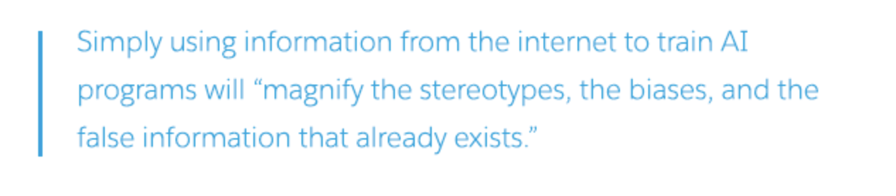

Inclusion in Big Data
Because many clients do not understand the economic value and importance of inclusion as well as concerns around data ethics, the topic may not arise unless a proactive stance is taken by the data services company as in these examples:

Slide 24
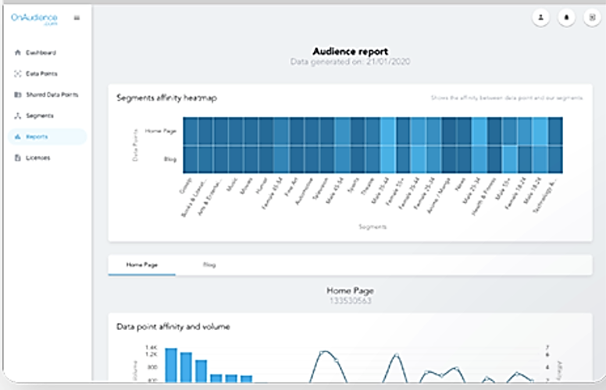
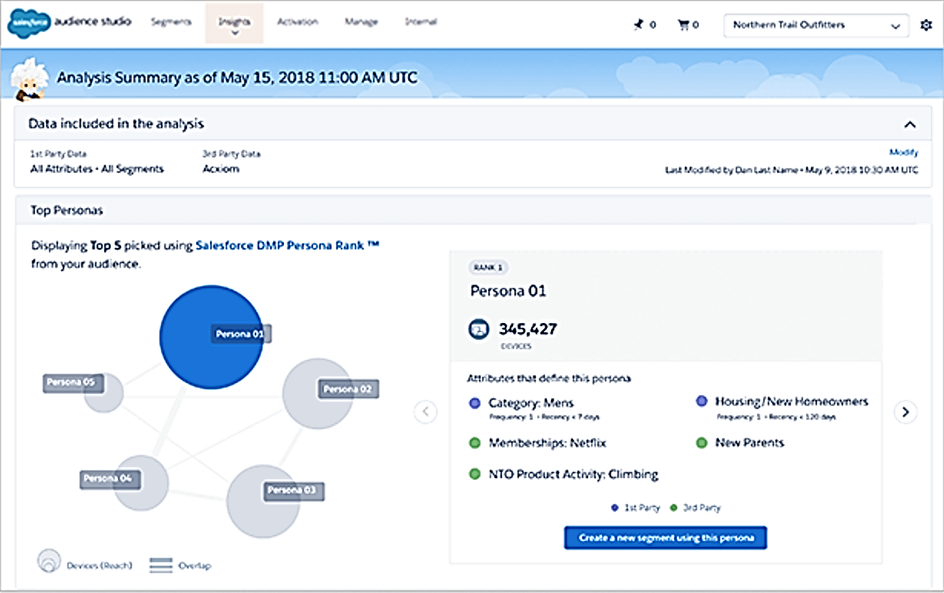
Data Management Platforms (DMP)
Companies offering data management platforms (DMP) may help automate data science functions
OnAudience provides data science tools in their DMP
Salesforce’s DMP uses a proprietary AI to analyze data

Slide 25
Takeaways
Clients often expect help interpreting data; bias awareness is a needed skill for data service providers
Most Data Service Provider messaging is focused on appealing to traditional business values (ROI, conversion, better decision making)
Data privacy and consent are the most common ethical concerns addressed; inclusion is mentioned rarely
A proactive stance on inclusion and ethics by data service providers can help educate clients on its business value
DMPs that automate data science functions can support inclusion if the platforms are designed inclusively from the start

Slide 26
AI Firms

Slide 27
Canadian AI Companies
40
Companies
20
Types of service
Inclusion Criteria:
Highest average monthly website visits or amount of venture capital funding
Research Focus:
What is the main messaging communicated by popular Canadian AI companies?

Slide 28
Number of the 40 Identified Companies that Address Ethical Concerns or Fairness
16 Address ethical concerns
9 Address issues of fairness or inclusion

Slide 29
Business needs (intellligence + hiring) make up largest category within AI firms
Count of AI Firms by Type of Service

Slide 30
Count of AI Firms by Province

Slide 31
Company Messaging
Many website messages position AI as a benefit and solution to human limitations
“Imagine the experiences you could deliver by embracing the cloud, data, and AI today”
- Coveo
“Making business more human–with AI”
-Integrate.ai
“Our AI enablement tools save you time in the necessary steps of labelling data and training AI models”
-Element AI
“Use your humans wisely, automate with ADA”
-ADA
“We know the complexities of dermatology can be daunting, so we’ve developed a tool to provide you with an instant second opinion”
-Triage
“4x more accurate than traditional selection methods at matching people to jobs where they thrive”
-Plum.io

Slide 32






Ethical AI in Canada
Canadian AI firms may be beginning to see the importance of fairness and inclusion in AI

Slide 33
Takeaways
Business needs (intelligence + hiring) make up largest category of AI firms
Majority of website messaging positions AI as a benefit and solution to human limitations
Canadian AI Firms may be beginning to acknowledge the importance of fairness and inclusion in AI

Slide 34
For more information visit
https://wecount.inclusivedesign.ca
https://idrc.ocadu.ca

